Slide 1
Patient safety professional standards – responding to patient safety incidents 2024
THIS PRSENTATION IS DESIGNED TO BE USED AND ADAPTED AS REQUIRED FOR TEACHING PURPOSES. IT IS NOT INTENDED FOR COMMERCIAL USE.

Slide 2

Who is this presentation for?
Anyone who wants to know more about the updated patient safety professional standards on responding to patient safety incidents and what changes were made.

Slide 3
What’s in this presentation?
Background
The update
What was updated
Supporting resources
Examples of use in practice and supporting resources
The standards
Structure and content of standards 1–7
Reason for update, update process, open consultation
What are they? Who are they for? Why do we need them? How should they be used? Where are they?
Key changes – standards and website

Slide 4
Background
1

Slide 5


Background
The RPS, Association of Pharmacy Technicians (APTUK) and Pharmacy Forum NI published:
Professional standards for the reporting, learning, sharing, taking action and review of incidents
2016
2024
They updated the standards and published them as:
Patient safety professional standards – responding to patient safety incidents
Notes:
Suggested points for discussion:
Background
RPS, Association of Pharmacy Technicians UK (APTUK) and Pharmacy Forum of Northern Ireland originally published the ‘UK Professional standards for the reporting, learning, sharing, taking action and review of incidents’ (or error reporting professional standards) in 2016.
Those professional standards:
Described good practice, quality pharmacy services, or what ‘good’ looks like and systems of care for the reporting, learning, sharing, taking action and review of incidents as part of a patient safety culture to improve rates of incident reporting
Protected people who used pharmacy services and improved patient safety.
They were published during a period when the profession was advocating for the ‘decriminalisation’ of dispensing errors and were part of the RPS contribution to enable rebalancing and a quality systems approach.
What’s happened?
In April 2024, RPS, APTUK and Pharmacy Forum Northern Ireland reviewed and updated the 2016 ‘UK Professional standards for the reporting, learning, sharing, taking action and review of incidents’ (or error reporting professional standards) in collaboration with an expert steering group
The standards are now called ‘Patient safety professional standards – Responding to patient safety incidents’ and replace the 2016 version.

Slide 6





What are these updated standards?
A generic set of patient safety professional standards on responding to patient safety incidents.
They’re not mandatory but are developed by the profession and describe quality pharmacy services or what ‘good’ looks like for reflecting, reporting and recording incidents, sharing learning, taking action, reviewing and evaluating as part of a patient safety culture.
They describe clear expectations and outcomes to help you demonstrate good professional practice, patient safety, systems of care and effective working practices.
They support pharmacy professionals to meet regulatory standards.
Notes:
Updated standards

Slide 7



Who are they for?
Anyone delivering pharmacy services (provided internally or outsourced in the NHS and independent sector).
Pharmacy professionals working in other healthcare settings.
Anyone working within the pharmacy, e.g., pharmacists, superintendents, chief pharmacists, pharmacist prescribers, pharmacy technicians, pharmacy assistant technical officers, all pharmacy trainees and students (foundation pharmacists, technicians and assistants) and pharmacy managers etc.
All individuals involved in delivering pharmacy services are equally responsible and accountable for contributing to a culture that supports patient safety, regardless of their role, registration status or professional body.
Notes:
Suggested points for discussion:
These standards apply equally to anyone delivering pharmacy services, pharmacy professionals working in other healthcare settings and anyone working within the pharmacy including (but not limited to):
Pharmacists (including superintendents and chief pharmacists)
Pharmacist prescribers
Pharmacy technicians
Pharmacy assistant technical officer
All pharmacy trainees and students (foundation pharmacists, technicians and assistants)
Pharmacy managers.
The standards apply to the above in all sectors across the United Kingdom, regardless of their professional background or setting.

Slide 8






Others who may find them useful
Pharmacy employers, commissioners of pharmacy services, pharmacy leadership teams, those accountable for procuring a pharmacy service and NHS organisations may find these standards useful to improve the systems and working environments that enable and encourage a just reporting culture and shared learning.
The standards may also be of interest to the public, people who use pharmacy and healthcare services and healthcare professionals working with pharmacy teams, to understand how people who use pharmacy services are protected.
8

Slide 9

Why do we need them?
GPhC standards for pharmacy professionals require pharmacy professionals to help people ‘maintain and improve their health, safety and wellbeing’. Their standards for the initial education and training of pharmacists’ states ‘Patient safety must come first’. Therefore, patient safety and wellbeing are essential to delivering pharmacy services.
Provides a common set of standards supporting patient safety when responding to incidents, across pharmacy services and professionals the UK, regardless of background, sector or setting.
Their implementation and maintenance are important to inform and improve practice, development, standard of care, culture, systems and services that are safe, effective and put the needs of people first.
Helps to improve patient safety and wellbeing and protect people who use pharmacy services who expect an engaged, person-centred approach to patient safety.

Slide 10





How should they be used?
Alongside relevant regulatory standards, statutory and professional duty of candour requirements, employer’s, organisational and national policies, indemnity arrangements and legal reporting in each of the home nations.
Within your scope and remit.
To inform, develop and implement local and organisation policies and services.
With the supporting resources webpage to help implement the standards.
In context to reflect on different areas of practice, levels of expertise and settings.
Notes:
Suggested points for discussion
How to use the standards
These standards should be used in conjunction with relevant regulatory standards, statutory and professional duty of candour requirements, employer’s, organisational and national policies, your indemnity insurance arrangements and legal reporting arrangements in place in each of the home nations
The standards should be used within your scope and remit and escalated where relevant and appropriate
Clarity of roles and responsibilities for actions and decisions for meeting each standard should be delegated by organisations, i.e., at an individual or leadership level (where relevant and appropriate).
The standards can be used to inform, develop and implement local and organisation policies and services
These standards should be applied when risk-assessing new services and when using new and evolving technology.
The supporting resources page on the RPS website can be used to facilitate the implementation of the standards
It is a generic set of standards; therefore, it does not contain statements that relate to specific areas. The standards must be contextualised to reflect different areas of practice, levels of expertise and settings.

Slide 11


Where are they?
The patient safety professional standards will be maintained on the RPS website.
RPS Patient safety professional standards – responding to patient safety incidents home page
Notes:
These standards are:
On the RPS website
Open access
Easily searchable on website – don't need to memorise the hyperlink.

Slide 12
The update – reason, process and consultation
2

Slide 13
Why update?
Over 1,500 unique users annually
Review date
NHS England patient safety incident response framework (PSIRF)
NHS England systems engineering initiative for patient safety framework (SEIPS)
GPhC keeping patients safe: being open and honest when things go wrong
GPhC pharmacy team toolkit: learning from incidents
Just culture
Duty of candour
The pharmacy (preparation and dispensing errors – hospital and other pharmacy services) order 2022
RPS GPhC joint statement on the position of professional standards
Updated terminology
Community pharmacy focused, needs expanding due to an evolving pharmacy landscape and expanding roles
For further information on how the standards were updated, please see the RPS website
Notes:
Suggested points for discussion
Why were the standards updated?
With over 1,500 unique users viewing the error reporting standards annually on the RPS website. They’re widely used in practice and, therefore, it was essential to update these standards to include the latest legislative, regulatory and national updates
The 2024 update of the standards was a review of an existing 2016 edition, which was due for review in November 2020
With an evolving pharmacy landscape and expanding roles, a review of these standards was required to ensure it remains fit for purpose
Since the 2016 standards, there have been various changes and updates which needed to be included in the update of the standards. These included:
NHS England Patient Safety Incident Response Framework (PSIRF) (August 2022) which replaces the Serious Incident Framework (SIF) (2015)
NHS England Systems Engineering Initiative for Patient Safety framework (SEIPS) (August 2022)
GPhC Keeping patients safe: being open and honest when things go wrong (June 2022)
GPhC Pharmacy team toolkit: learning from incidents Examples of notable practice from our Pharmacy Inspections Knowledge Hub (June 2022)
Updated terminology
Just culture
Duty of candour
The Pharmacy (Preparation and Dispensing Errors – Hospital and Other Pharmacy Services) Order 2022 – The 2018 legal defence was further extended to hospitals, care homes and prisons in 2022
RPS GPhC joint statement on the position of professional standards (June 2022).

Slide 14





How were they updated?
Steering group assembled. Scoping. Group agreed update approach. Group reviewed consultation questions
Open consultation for external review (6 weeks)
Consultation analysed. Group reviewed consultation feedback. Comments from consultation incorporated to create first draft
Drafts reviewed by group. Final draft tested by patient groups
Standards finalised, published on website
For further information on how the standards were updated, please see the RPS website
Notes:
Suggested points for discussion
How the standards were updated
An expert steering group was recruited to provide strategic oversight of the update
27 patient safety experts from different sectors and settings were invited to join from across the UK including representatives from professional regulators, professional organisations, lay members and other relevant and interested stakeholder groups.
For further information on who was involved in the update, please see the background page on the RPS website
A six-week public consultation informed the update. The steering group designed the questions, and it was disseminated through the RPS website and networks. The consultation included 17 questions on how these standards could be more current and within scope. Results were analysed using text and descriptive analysis. The group used a consensus process to review and update the standards.
The draft went through final testing with expert patients and patient groups for comment
The revised version was published on the RPS website on 24th April 2024.

Slide 15





Consultation summary
Consultation ran from 21 April 2023 until 2 June 2023
48 responses for 17 questions
The RPS asked for feedback on how the standards could be more current, within scope and fit for purpose
Feedback was mainly positive and showed the standards are used and needed to support patient safety
15
Notes:
Suggested points for discussion
What was the feedback from the consultation
In general, there was positive feedback that the standards were clear, concise and easy to read
However, they needed to be improved with supporting resources and clarity on what is expected and of whom, e.g., roles and responsibilities
Clarity was requested around expectations and outcomes that demonstrate good professional practice, patient safety, systems of care and effective working practices
Suggestions to include case studies and examples of good practice of what could to be done to achieve each standard, i.e., what ‘good’ looks like
Current terminology and key themes were identified for inclusion such as just culture, duty of candour, human factors, Safety II, and systems-based thinking (see next slide)
There were many resources recommended to support use of the standards including the latest legislative, regulatory and national updates, such as the NHS England patient safety incident response framework and the pharmacy (preparation and dispensing errors hospital and other pharmacy services) order 2022
The following sat outside the scope of the standards:
Suggestions on improving national and local reporting methods (simplifying processes or IT systems) – these issues related to the reporting process or IT systems need to be addressed by relevant organisations and may lie with lobbying or local system changes
Processes and organisational requirements – processes/methodologies will have to be determined locally and individually through risk assessments (e.g., staffing levels, protected learning time and support from senior managers)
How to check standards are adhered to – it’s important to remember professional standards support best practice, and it’s up to individuals and organisations to be accountable and self-govern their practice.

Slide 16
Consultation – hot topics for inclusion
Accountability
Incident analysis and data
Audits
Benchmarking
Benefit of reporting
Communications, discussion, collaboration, involvement
Continuous professional development
Contributory factors, themes, trends, patterns, behaviours
Duty of candour
Culture – learning, support, praise, good practice and behaviours
Evaluate outcomes
Terminology
GDPR
How to support resources – errors identified by a different organisation, how to share and who to share with and involve
Human factors
Improvement methodologies and mechanisms
Inclusivity
Investigations
IT investigation tools and systems
Just culture
Learning culture
Learning from others and incidents/near misses to inform improvement and implementation
Legal defence for errors in hospitals, care homes and prisons
Local and national reporting mechanisms
Networks
Existing process and policies, national, local and regulatory guidelines
Indemnity
Promoting psychological safety
PSIRF
Quality Improvement in Pharmacy Practice group framework, Scotland
Reactive and proactive actions (immediate corrective and preventative actions)
Record and report
Reflection
Resources needed, e.g., staff and time
Risk – identification, management and mitigation
Roles and responsibilities
Root cause
RPS GPhC joint statement position of professional standards
Safety I and safety II approach
Safety interventions – effectiveness, impact
SEIPS
Share learning
Sustainability
Systems-based thinking, e.g., learning and changes
Training
Whistleblowing
Notes:
These are the hot topics identified through the consultation that needed adding.

Slide 17
What was updated Key changes

Slide 18



Key changes
Updated
Scope – generic and expanded audience, sector and setting
Some standards
Some descriptor outcomes
References
Terminology and included key topics.
New
Title
Introduction
Purpose section
Some standards
Some descriptor outcomes
Supporting statements
‘Further information’ section providing examples
Glossary section.
Removed
Sections 3 and 4 and updated and integrated them into the purpose section
Sections 5 and 6 and updated and integrated them into the supporting resources page.
For further information on all the changes and why they happened, please see the RPS website
Notes:
Suggested points for discussion
These are the key changes on the slide e.g.:
A new title was created ‘Patient safety professional standards responding to patient safety incidents’ to encompass all patient safety incidents, not just errors. The glossary defines what a patient safety incident is in terms of the standards.
A generic scope and expanded audience were adopted to include all pharmacy services. It applies to anyone delivering pharmacy services, pharmacy professionals working in other healthcare settings and anyone working within the pharmacy, regardless of professional background or setting
The updated standards provide more clarity on achieving patient safety for the expanding pharmacy workforce
All requested through consultation and steering group review
For further information on all the changes and why they happened, please see the background page on the RPS website.

Slide 19
What was updated Website

Slide 20





What’s new on the website
Web version
PDF
Background page – summary of changes
Supporting resources – case studies and examples of learning and best practice
Improved navigation with hyperlinking to glossary terms, further information sections and references
For further information, please see the RPS website
Notes:
Suggested points for discussion:
New web version
New PDF
New background page with section on what’s been updated (as requested through the open consultation)
New supporting resources page

Slide 21

Standards – main web page
Read the standards
Read in-browser or download the patient safety standards
Supporting resources
Examples of how to use the standards, and supporting links
Background
Summary of changes, the process and more
For further information, please see the RPS website
Notes:
Suggested points for discussion:
Open access pages
New main hub page with three new subpages (as requested through the open consultation)
Subpages include:
Standards page
Supporting resources
Background.
Further detail in next slides.

Slide 22
Standards page

Slide 23
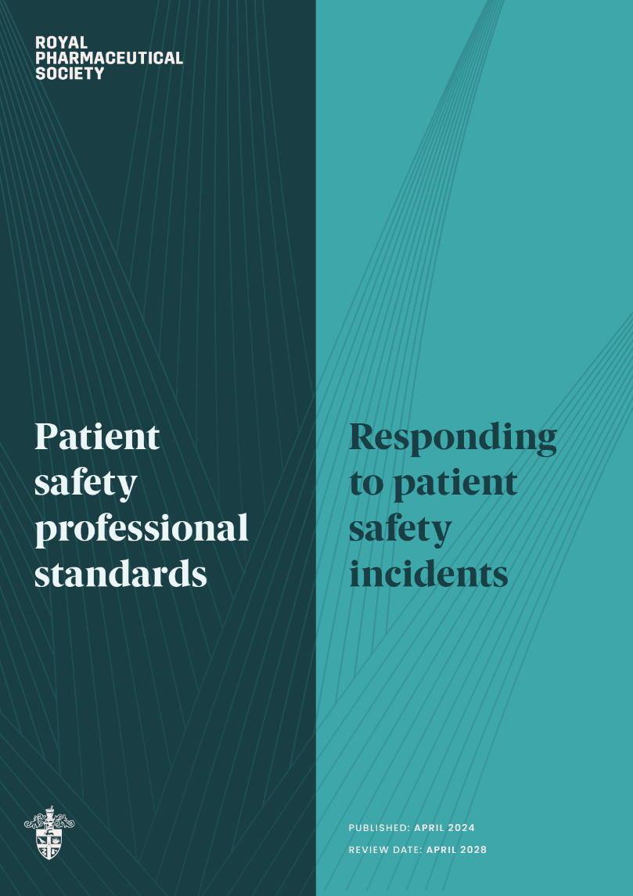
Notes:
Here you will find a new PDF and new interactive web version with improved navigation and hyperlinking to glossary terms, further information sections and references.

Slide 24
Supporting resources page

Slide 25

Supporting resources content
What patient safety incidents to record and report
How to deal with patient safety incidents identified by another organisation
Where to report patient safety incidents
Where to report patient safety incidents
Resources to help you understand the standards
Ways to encourage a patient safety culture in the workplace
Sharing best practice
Further supporting links and resources
For further information on the supporting resources, please see the RPS website
Notes:
Here you will find some useful links and further reading to support you with demonstrating and implementing the standards and supporting statements in practice, with best practice examples (as requested through the open consultation).
On this page you'll find:
What patient safety incidents to record and report
How to deal with patient safety incidents identified by another organisation
Where to report patient safety incidents
Resources to help you understand the standards – signposting links
Ways to encourage a patient safety culture in the workplace – just culture and shared learning culture
Sharing best practice – case studies and examples – here you will find ways others have demonstrated good practice when responding to patient safety incidents in their day-to-day practice. The RPS also asks you to share your examples with support@rpharms.com
Further supporting links and resources – more useful further reading
This PowerPoint presentation on the content of the standards and the updates. It can be used and adapted as required for learning purposes only. However, it is not to be used by external users/organisations for commercial gain.
The RPS is keen to hear about the resources you use to support the implementation of the standards in practice. To support users, you can share your suggestions that the RPS haven’t mentioned by emailing them at support@rpharms.com.

Slide 26
Background page

Slide 27

Background page content
Background
Why the standards were updated
Summary of changes
How the standards were updated
Development and timeline
Acknowledgments and endorsements
For further information on the background page, please see the RPS website
27
Notes:
Here you’ll find information on the following:
Background
What are the patient safety professional standards and why are they important?
Why the standards were updated
How the standards were updated
How can they be used?
Summary of changes – further detail of what’s been updated and why
Multidisciplinary engagement – steering group
Consultation
Development process and timeline
Who updated and endorsed the standards?

Slide 28
The standards 1–7 Structure and content
3
Notes:
Use standards alongside the ‘further information’ sections and supporting resources webpage.

Slide 29

Previous standards
Standard 1:
Open and honest
Be open and honest when things go wrong
Standard 2:
Report
Report patient safety incidents to the appropriate local or national reporting programme
Standard 3: Learn
Investigate and learn from all incidents, including those that cause harm and those that are ‘no harm’ or ‘near-miss’
Standard 4: Share
Share what you have learnt to make local or national systems of care safer
Standard 5: Act
Take action to practice or improve local or national systems of care
Standard 6: Review
Review changes to practice
Notes:
Suggested points for discussion:
Here’s a reminder of the standards in the previous version – there were 6

Slide 30

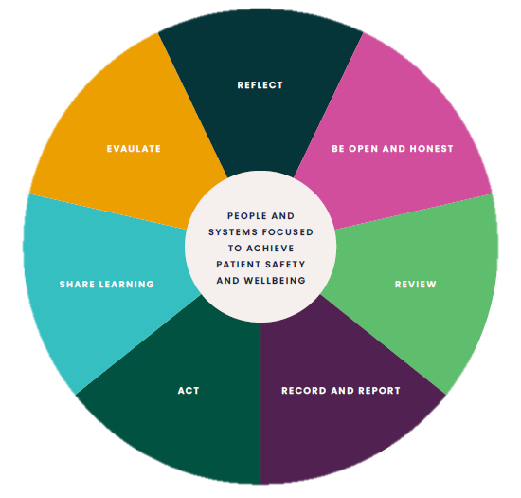
New standards
Structure of the standards:
STANDARD
Outcome and expectation.
DESCRIPTOR OUTCOME
Under each standard is a sentence that supports attainment of the standard by describing the outcome that should be actively and routinely demonstrated.
SUPPORTING STATEMENTS
Under the descriptor outcomes are supporting statements explaining how a standard and descriptor could be demonstrated.
FURTHER INFORMATION
The further information sections under each supporting statement provide information and examples (list not exhaustive or definitive), which provide clarity and meaning to the supporting statements. The recommendation is to use the standards alongside any relevant further information sections to support their implementation into your practice.
Notes:
Suggested points for discussion:
Structure of the standards
There are now seven standards (which outline the outcome and expectation):
New – ‘reflect’ and ‘evaluate’
Updated – ‘be open and honest’ and ‘record and report’
Merged – ‘share’ and ‘learn’.
Seven new or updated descriptor outcomes – which describe the outcome that should be actively and routinely demonstrated to support attainment of each standard
37 new supporting statements – under the descriptor outcomes are supporting statements explaining how a standard and descriptor could be demonstrated
33 new further information sections – providing information and examples (list not exhaustive or definitive), which provide clarity and meaning to the supporting statements
New figure 2 – New structure of the standards to replace previous diagram adapted from the Community Pharmacy Patient Safety Group Record, Learn, Share, Act, Review (RSLAR) wheel – patient at centre and new standards surround it.
Please note:
The standards and supporting statements are inter-dependent and are not in any particular order. The numbering is mainly to support mapping purposes and does not reflect the level of importance of the statement. They are not designed to be used as a script or in isolation
Due to the generic nature of the standards, it may be that not every standard, descriptor outcome or supporting statement is relevant to your role, practice or setting. However, you should still be able to consider how it could be demonstrated
You can start anywhere depending on the individual circumstances, concern, incident or need – it’s important to start
They are interactive – e.g. click on any standard in the diagram to be directed to that standard.

Slide 31
Standard 1: Reflect (new)
Proactively and regularly reflect on existing knowledge, understanding, safety culture and systems, to identify gaps around responding to patient safety incidents and improve the delivery of safe and effective person-centred care.
1.1 Understand your own and others’ roles and responsibilities when responding to patient safety incidents, and encourage others to do the same
1.2 Understand work system-based factors and approaches when responding to patient safety incidents
1.3 Identify learning needs through individual reflection and continuous professional development, and encourage and support others to do the same
1.4 Review and address issues and concerns about responding to and escalating patient safety incidents
1.5 Develop, review, understand and implement appropriate processes and policies for identifying and responding to patient safety incidents using relevant national, local and regulatory guidelines
1.6 Ensure there are sufficient resources, and access and training to relevant IT tools and systems to support the process of responding to patient safety incidents.
Notes:
Suggested points for discussion:
This is about self-reflecting on existing knowledge, understanding, safety culture and systems to identify gaps and make improvements before an incident happens. You can do this by:
Making sure you understand roles (which may include those outside the immediate team) and responsibilities (e.g. who is responsible for what, and when to escalate)
Understanding the work system-based factors (e.g., tools, technology, tasks, people, organisations, internal and external environment) and approaches (may include looking at interrelationships and patterns, and using a structured process to deliver a socio-technical system, e.g. looking at needs, requirements, design, delivery that impacts on process (work done) and desired outcomes (related to performance and wellbeing), that can impact patient safety incidents
Undertaking continuous professional development, (e.g., reading current guidelines and training)
Addressing any issues and concerns that may become a barrier to reporting, (may include fear of blame and consequences, issues or concerns)
Developing and implementing appropriate processes and policies (by involving the relevant people e.g end users, experts, managers and staff to develop processes and policies on for example what, how and where to record and report, how to raise a patient safety incident, who to raise concerns with, how to learn from patient safety incidents, using risk management systems, understanding the risk tolerance of organisations and how to identify and respond to patient safety incidents)
Making sure you have sufficient resources (e.g., staff, time, investigation and analytical skills, technology, SOPs, supporting networks), and access and training to relevant IT tools and systems to support the process of responding to patient safety incidents, (e.g., recording, reporting, incident analysis, risk identification, risk assessments and thematic review).
New key themes:
Being proactive, regular reflection, safety culture, systems, existing practice, identify gaps and learning needs, improving the delivery of safe and effective person-centred care, understanding your own and others’ roles and responsibilities, continuous professional development, work-system based factors, socio-technical systems, system-based approaches, addressing issues and concerns, developing processes and policies collaboratively, causes of errors, barriers to reporting, using existing national, local and regulatory guidelines, training, access to IT tools and systems and having resources in place, e.g., staff and time, SEIPS, risk tolerance, risk management and thematic review.

Slide 32
Standard 2: Be open and honest
Be open, honest and responsive when a patient safety incident occurs, to support professional accountability and the individuals affected by the incident.
2.1 Create and promote a just culture in the workplace with an environment that supports psychological safety and enables individuals to feel confident, supported and empowered to speak up and raise patient safety incidents without fear
2.2 Follow any relevant regulatory guidance as well as any relevant national, workplace or local policies and procedures
2.3 Open lines of communication with individuals affected, your employer, relevant organisations and anyone involved in the incident and the person’s care
2.4 Actively listen to the individuals affected by the patient safety incident in a respectful, compassionate, non-judgemental and non-defensive way, and check their immediate safety and wellbeing
2.5 Engage with individuals affected by the patient safety incident (where relevant and appropriate) by providing information and support
2.6 Involve individuals affected by understanding their expectations regarding how they would like the patient safety incident to be resolved and how they would like to be kept informed of developments.
Notes:
Suggested points for discussion:
Previously: Standard 1: OPEN AND HONEST – Be open and honest when things go wrong
This is about being open, honest and responsive when a patient safety incident occurs to support people (e.g., the person affected, their family, carers, the person who raised or reported the incident, colleagues or pharmacy team members) and support professional accountability. You can this by:
Creating and promoting a just culture in the workplace, support psychological safety, enable individuals to feel confident, supported and empowered to speak up and raise patient safety incidents without fear
Following relevant regulatory guidance, national, workplace or local policies and procedures, (e.g., statutory and professional duty of candour, raising concerns)
Opening lines of communication (by adapting to communication needs, e.g., language, age, capacity, learning disability and physical or sensory impairments or providing digital or paper formats) with individuals affected, your employer, relevant organisations (e.g., regulator or indemnity provider) and anyone involved in the incident and the person’s care
Actively listening to the individuals affected by the patient safety incident (including staff and patients) in a respectful, compassionate, non-judgemental and non-defensive way, and checking their safety and wellbeing
Engaging with people affected by the patient safety incident by providing information (e.g., answering questions, informing on the complaint management procedures, what to expect and timescales), providing regular feedback (e.g., to individuals affected and the person who raised the patient safety incident) and support (e.g., signposting to advocacy services, charities, support networks and Yellow Card self-reporting)
Involving individuals affected by understanding their expectations regarding how they would like the patient safety incident to be resolved and how they would like to be kept informed of developments.
New key themes:
Be responsive, accountability, just culture, psychological safety, promoting psychological safety, duty of candour, transparency, whistleblowing, empowerment, accountability, challenging poor practice without fear, who to be open with and who to keep informed and involved, wellbeing, safety, communication needs, involving affected individuals, actively listening, providing information and support and MHRA Yellow Card self-reporting.

Slide 33
Standard 3: Review
Review all patient safety incidents in a timely manner to identify an appropriate response or action, identify contributing factors, manage risk and support safety interventions and learning.
3.1 Review all patient safety incidents to determine an appropriate response or action
3.2 Gather relevant data from available sources to understand what happened
3.3 Analyse data to provide insight and highlight patient safety incidents that require a systems-based investigation
3.4 Investigate patient safety incidents (where relevant and appropriate) using the appropriate incident-investigation methodologies and tools
3.5 Undertake thematic reviews of reported patient safety incidents to identify underlying patient safety issues, rather than purely responding to individual incidents
3.6 Identify system-based interventions, or solutions for improvement using the appropriate improvement methodologies and mechanisms
3.7 Understand why the patient safety incidents occurred by identifying the learning, contributory factors, risks, themes, trends, patterns, behaviours and frequency, and document these (even if none are identified).
Notes:
Suggested points for discussion:
Previously: Standard 6: REVIEW – Review changes to practice
This is about reviewing all patient safety incidents in a timely manner to identify an appropriate response or action, identify contributing factors, manage risk and support safety interventions and learning. You can this by:
Reviewing all patient safety incidents to determine an appropriate response or action (e.g., making enquires, investigating, reporting externally, doing an independent investigation, delegating roles, writing a review of the incident, identifying problems, making recommendations, taking any corrective or preventative measures)
Gathering relevant data (e.g., taking details of the patient safety incident from the individuals affected, reported patient safety incidents, audits, complaints, compliments, peer discussions or near miss logs) from available sources to understand what happened
Analysing data to provide insight and highlight patient safety incidents that require a systems-based investigation
Investigating patient safety incidents using the appropriate incident-investigation methodologies and tools
Undertaking thematic reviews of reported patient safety incidents to identify underlying patient safety issues, rather than purely responding to individual incidents
Identifying system-based interventions or solutions for improvement using the appropriate improvement methodologies and mechanisms
Understanding why the patient safety incidents occurred by identifying the learning, contributory factors (e.g., including tools, technology, tasks, people, organisations, internal and external environment, human factors or complex factors), risks, themes, trends, patterns, behaviours and frequency, and document these (even if none are identified).
New key themes:
Investigate in a timely manner, contributing factors, determine an appropriate response or action, gather and analyse data, systems-based, investigate, thematic reviews, system-based interventions, risks, themes, trends, patterns, behaviours, frequency, documentation, enquires, corrective or preventative measures, recommendations, audits, complaints, compliments, peer discussions, near miss logs, environment, technology, people, work systems, socio-technical systems, human factors, complex factors, incident analysis, risk identification, identify root cause, support safety interventions and learning, incident investigation tools, improvement methodologies and mechanisms, SEIPS, systems-based learning, involve others and Safety I and II approach.

Slide 34
Standard 4: Record and report (new)
Record and report in a timely manner using the appropriate internal, local and national reporting mechanisms, regardless of where the patient safety incident originated, to improve patient safety by monitoring and identifying issues that need escalating, enable learning and facilitate the development of local, regional and national solutions.
4.1 Record and report information and patient safety incidents (where relevant and appropriate) using the appropriate mechanisms and reporting systems
4.2 Effectively and securely communicate information, ensuring that private and personal data is protected and communicated securely in line with relevant legislation/regulations
4.3 Communicate information with individuals and organisations (where relevant and appropriate) for the purpose of discussion, advice, collaboration, learning and/or to involve them.
Notes:
Suggested points for discussion:
Previously: Standard 2: REPORT – Report patient safety incidents to the appropriate local or national reporting programme
This is about recording and reporting in a timely manner using the appropriate mechanisms, and escalating where needed regardless of where the patient safety incident originated, You can do this by:
Using the appropriate mechanisms and reporting systems (e.g., internal, local and national)
Effectively and securely communicating information (e.g., good practice, culture, service quality, excellence, information given or received, discussions had, advice given, updates or who you involved and having open discussions among teams about patient safety incidents to help generate new ideas) ensuring that private and personal data is protected in line with relevant legislation/regulations
Communicate information with the right people (e.g., healthcare professionals, the wider healthcare team, colleagues or people affected by the patient safety incident, their families and/or carers) and organisations (for the purpose of discussion, advice, collaboration, learning and/or to involve them).
New key themes:
Timely, internal, local and national reporting mechanisms, escalation, facilitate learning, record, report, information, reporting systems, secure, data protection, discussion, advice, collaboration, learning, what to report and record, good practice, culture, service quality, who you involved, generate new ideas, motivation to report and how to deal with errors identified by a different organisation.

Slide 35
Standard 5: Act
Take relevant action in a timely manner to manage risk, strengthen, change or improve the quality of practice or systems of care (including e-Systems) in a sustainable way, and minimise recurrence by addressing contributory factors (where relevant and appropriate).
5.1 Identify and actively manage the contributory factors, system weaknesses and latent hazards using a systems-based and risk-management approach to understand why the patient safety incident occurred
5.2 Assess, develop and implement the required immediate corrective measures
5.3 Assess, develop and implement the required proactive preventative measures
5.4 Measure impact and monitor effectiveness of existing processes and new interventions and changes made to practice using appropriate data collection tools and improvement methodologies
5.5 Recognise and acknowledge good practice and behaviours when responding to patient safety incidents
5.6 Implement any learning from patient safety incidents and relevant actions with relevant individuals
5.7 Provide feedback and support to the person that raised the patient safety incident and to colleagues involved in the patient safety incident.
Notes:
Suggested points for discussion:
Previously: Standard 5: ACT – Take action to change practice or improve local or national systems of care
This is about taking relevant action in a timely manner to manage risk, strengthen, change or improve the quality of practice or systems of care in a sustainable way (longevity to continue processes and to maintain the environmental needs of the future), and minimise recurrence. You can do this by:
Identifying and actively managing the contributory factors, system weaknesses and latent hazards using a systems-based and risk-management approach to understand why the patient safety incident occurred
Assessing, developing (collaborating with colleagues and teams to identify needs and requirements, and to design, deliver and test new ways of working or interventions) and implementing the required immediate corrective and proactive preventative measures
Measuring impact and monitoring effectiveness of existing processes and new interventions and changes made to practice
Recognising and acknowledging good practice and behaviours when responding to patient safety incidents
Implementing any learning from patient safety incidents and relevant actions with relevant individuals
Providing feedback and support to the person that raised the patient safety incident and to colleagues involved in the patient safety incident (e.g., how and where to seek confidential advice and mental health first aid).
New key themes:
Timely, manage risk, quality of practice, systems of care, e-Systems, sustainability, addressing contributory factors, system weaknesses, latent hazards, systems-based approach, risk-management approach, understand why the incident occurred, develop, reactive, proactive, corrective measures, preventative measures, measure impact, monitor effectiveness, interventions, data collection tools, improvement methodologies, behaviours, implement learning, feedback, acknowledge good practice, support, design, collaborate to identify needs, test, roles and responsibilities, required response, strengthen, improve, system changes, follow up and minimising risk.

Slide 36
Standard 6: Share learning (new)
Share learning from appropriate patient safety incidents with relevant individuals and organisations to improve patient safety, promote a learning culture and minimise future risks where relevant and appropriate.
6.1 Create and encourage a supportive learning culture and environment to inform improvement
6.2 Share relevant learning from patient safety incidents and thematic reviews in a timely manner with relevant individuals and organisations using available sharing mechanisms so that information can be cascaded internally, locally and nationally
6.3 Raise awareness of the benefit and impact of recording, reporting, learning, sharing or acting in response to patient safety incidents to embed this as good practice
6.4 Create regular opportunities to learn together – explore case studies, examine topical patient safety incidents and consider professional, clinical and legal responsibilities.
Notes:
Suggested points for discussion:
Previously: Standard 3: LEARN – Investigate and learn from all incidents, including those that cause harm and those that are ‘no harm’ or ‘near-miss’
Combined with:
Standard 4: SHARE – Share what you have learnt to make local or national systems of care safer
This is about sharing learning from appropriate patient safety incidents with the right people, organisations and through the right channels to promote a learning culture and making sure information is cascaded. You can do this by:
Creating and encouraging a supportive learning culture and environment in the workplace
Sharing relevant learning (e.g., best practice, positive outcomes to interventions, changes to practice, what went well, what could have gone better, types of errors, learning from others, information, advice, feedback, future prevention, risks and benefits of staff time spent reporting and recording) with relevant individuals and organisations (e.g., person who raised the patient safety incident, staff, internal teams, wider healthcare team, MSOs, CDAOs, patient safety teams, the MHRA, NHS England manufacturers, system vendors, or regulators) using available sharing mechanisms (e.g., incident reporting systems, internal communications, serious adverse event reviews, adverse event bulletins, education and training events, prescribing bulletins, MHRA Yellow Card reporting, local, regional and national networks and practice forums or GPhC notable practice examples).
Raising awareness of the benefit and impact of recording, reporting, learning, sharing or acting in response to patient safety incidents to embed this as good practice
Creating regular opportunities to learn together by exploring case studies, examine topical patient safety incidents and considering professional, clinical and legal responsibilities.
New key themes:
Share appropriate learning, who to share with, how to share, why share, learning culture and environment, sharing mechanisms, cascade internally, locally and nationally, benefit and impact of recording, reporting, learning, sharing or acting, learn together, professional, clinical and legal responsibilities, learning from incidents, learning from others, learning to inform improvement, learning from near misses, prevention better, networks, communications, what to share, what went well and what went wrong, inclusive of other professionals and cascade.

Slide 37
Standard 7: Evaluate (new)
Regularly evaluate systems, interventions and changes made to practice to assess outcomes of mitigating or preventing future risks and patient safety incidents.
7.1 Follow up on interventions and changes made to practice after an appropriate timeframe and at appropriate intervals (where relevant)
7.2 Interpret available data to assess the impact and effectiveness of interventions and changes made
7.3 Use a risk management approach to regularly evaluate if outcomes have been met or if new interventions and changes to practice have been identified that need actioning to mitigate future risk
7.4 Assess current systems used, including IT systems, and update where relevant and appropriate
7.5 Assess risk management procedures and update where relevant and appropriate to promote safety management.
Notes:
Suggested points for discussion:
This is about regularly evaluating interventions and changes made to practice to assess outcomes (i.e., has it prevented future risks or patient safety incidents?). You can do this by:
Following up after an appropriate timeframe and at appropriate intervals, (e.g., what went well and what could be improved?)
Interpreting available data to assess the impact and effectiveness of interventions and changes made
Regularly evaluating if outcomes have been met or if new interventions and changes have been identified that need actioning
Assessing current risk management procedures and systems used, including IT systems (e.g., prescribing and management systems) and updating if needed.
New key themes:
Regularly evaluate systems, interventions and changes made, assess outcomes, follow up, appropriate timeframe, appropriate intervals, interpret data, assess impact and effectiveness, risk management approach, have outcomes been met, new interventions identified, assess current systems, IT systems, update, risk management procedures, safety management, what is going well and what could be improved, prescribing and management systems.

Slide 38
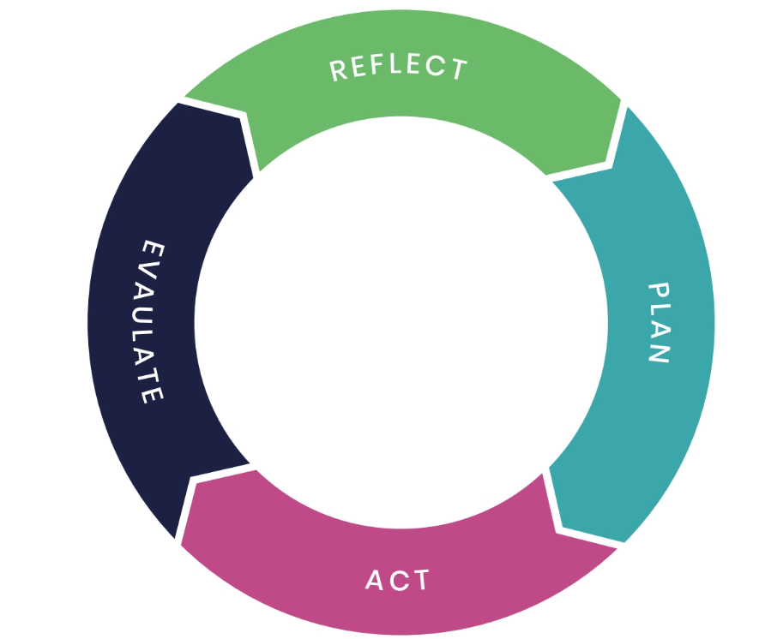




Next steps?
Reflect – How do you and your team currently deal with patient safety incidents? Do you know who does what? Do they align with current patient safety processes?
Plan – What could be improved?
Act – Share your examples of best practice and learning. Share with the RPS too at: support@rpharms.com
Evaluate – Review regularly and look for ways to continuously improve ways of working and safety culture.

Slide 39
Thank you

Slide 40
Q&A time

