Slide 1
A Competency Framework for all Prescribers
2021
THIS PRSENTATION IS DESIGNED TO BE USED AND ADAPTED AS REQUIRED FOR TEACHING PURPOSES. IT IS NOT INTENDED TO BE USED TO COMMERCIAL USE.

Slide 2

Who is this presentation for?
Prescribers
Employers
Higher education institutes
Non-medical prescribing leads
Designated prescribing practitioners to support trainees
Those involved with delivering training and support to prescribers
Notes:
This presentation is designed be used and adapted as required for teaching and learning.
It is not intended to be used for commercial use.
Pink slides = 2021 update specific

Slide 3
What’s in this presentation?
Background
The update
What was updated
The framework
Structure and content of competencies 1-10
Supporting tools
Examples of use in practice, Evidencing competencies and Supporting resources
Reason for update, Update process, Open consultation
What is it? Who’s it for? How to use? Why needed? When published? Who’s involved?
Key changes - framework and website
Notes:
Covers the content of the framework and also the 2021 updates.

Slide 4
Background
1

Slide 5
What is it?
A structure which describes the demonstrable knowledge, skills, characteristics, qualities and behaviours central to a safe and effective performance in a prescribing role
Sets out what good prescribing looks like
A generic framework for all prescribers but it must be contextualised
Notes:
It is a generic framework for all prescribers regardless of their professional background or setting
It must be contextualised to reflect different areas of practice, levels of expertise and settings.
sets out what good prescribing looks like.
structure which describes the knowledge, skills, characteristics, qualities and behaviours which prescribers should demonstrate to prescribe safely and effectively
Due to the generic nature of the framework, it may be that not every competency or supporting statement is relevant to your practice or setting. However, you should still be able to consider how you could demonstrate the supporting statement.

Slide 6
Why do we need it?
To support all prescribers in prescribing safely and effectively
To inform and improve practice, development, standard of care and safety (for both the prescriber and patient)
To bring professions together and harmonise education for prescribers
To provide a common set of competencies which underpin prescribing regardless of professional background
Notes:
To provide a common set of competencies which underpin prescribing regardless of professional background
It provides the opportunity to bring professions together and harmonise education for prescribers and the quality and standards of prescribing by offering a competency framework for all prescribers.
To support all prescribers in prescribing safely and effectively.
Its implementation and maintenance are important in informing and improving practice, development, standard of care and safety (for both the prescriber and patient).

Slide 7



Who is it for?
All regulators, professional bodies, education providers, prescribing professions and patients/carers to use
Any prescriber at any point in their career
Independent prescribers, community practitioner nurse prescribers and supplementary prescribers
Notes:
All regulators, professional bodies, education providers, prescribing professions and patients/carers to use
Any prescriber at any point in their career regardless of their professional background or setting, but because of the generic nature, It must be contextualised to reflect different areas of practice, levels of expertise and settings.
Applies equally to independent prescribers, community practitioner nurse prescribers and supplementary prescribers

Slide 8
How can it be used?
As a self-assessment tool
To inform standards, the development of education, and to inform guidance and advice
To demonstrate delivery of the competencies required of the role
Further examples of uses can be found on the RPS website: https://www.rpharms.com/cfap
Notes:
As a self-assessment tool when expanding scope of practice, changing scope of practice or returning to practice.
Regulators, education providers, professional organisations and specialist groups can use it to inform standards, the development of education, and to inform guidance and advice.
Prescribing trainees can evidence the framework to demonstrate they are delivering the competencies required of their role.
Further examples of uses can be found on the RPS website: https://www.rpharms.com/cfap

Slide 9
When was it published?
2012
National Prescribing Centre/NICE published ‘A single prescribing competency’
2016
RPS published as ‘A competency framework for all prescribers’
2021
RPS updated framework
Notes:
2012 - To support all prescribers in prescribing safely and effectively, a single prescribing competency framework was published by the National Prescribing Centre/National Institute for Health and Care Excellence (NICE) in 2012. Based on earlier profession-specific prescribing competency frameworks, the 2012 single prescribing competency framework was developed because it became clear that a common set of competencies should underpin prescribing, regardless of professional background.
2016 - NICE and Health Education England approached the Royal Pharmaceutical Society (RPS) to manage the update of the framework on behalf of all the prescribing professions in the UK in 2015. The RPS agreed to revise and update the framework in collaboration with the other prescribing professions and members of the public . The competency framework for all prescribers was first published by the RPS in July 2016. Going forward, the RPS will continue to maintain and publish this competency framework
2021 – in 2020 there was a review of the existing 2016 edition that is widely used in practice. The 2021 update of the competency framework for all prescribers was published on the 7th September 2021.

Slide 10
Who was involved?
RPS in collaboration with a multi-disciplinary external task and finish group from across the UK
For further information on who was involved in the update, please see the RPS website:
https://www.rpharms.com/cfap
Notes:
Review and update:
A multi-disciplinary external task and finish group comprising representatives from professional regulators, professional organisations, prescribers from all prescribing professions, lay representatives and other relevant and interested stakeholder groups from across the UK was created to review and update the framework with RPS.
Task and finish group
The task and finish group consisted of representatives from :
British Dental Association
Chartered Society of Physiotherapy
College of Paramedics
General Pharmaceutical Council
Health and Care Professions Council
Health Education and Improvement Wales
National Institute for Health and Care Excellence
NHS Education for Scotland
Nursing and Midwifery Council
Representatives from across all prescribing professions, academia, primary and secondary care, and lay representatives
Royal College of General Practitioners
Royal College of Nursing
Royal Pharmaceutical Society
Society and College of Radiographers
The College of Optometrists
The Royal College of Midwives
Colleagues from across England, Scotland, Wales and Northern Ireland
For further information on who was involved in the update, please see the RPS website:
https://www.rpharms.com/cfap

Slide 11












Who was involved? - endorsements
Notes:
Endorsed by:
Association For Prescribers
British Dental Association
British Dietetic Association
British Pharmacological Society
Chartered Society of Physiotherapy
College of optometrists
College of Paramedics - new
Joint Council For Cosmetic Practitioners -new
Pharmaceutical Society of Northern Ireland/ pharmacy forum ni -new
Royal College Of Midwives – new
Royal College of Nursing
Royal College of Podiatry
Society of Radiographers
Royal College of General Practitioners

Slide 12
Where can I find it?
RPS will continue to maintain and publish the competency framework for all prescribers on the RPS website
RPS A Competency Framework for all
Prescribers home page:
https://www.rpharms.com/cfap
Notes:
* Open access
* Easily searchable on website - don't need to memorise the hyperlink

Slide 13
The update – reason, process and consultation
2

Slide 14
Why update?
REVIEW DATE
SPECIFIC ADVICE FROM DPP PROJECT BOARD
AND STEERING GROUP
TO REFRESH
COMPETENCY FRAMEWORK FOR DESIGNATED
PRESCRIBING PRACTITIONERS
PARAMEDICS
NEEDS TO BE CURRENT, RELEVANT AND
IN SCOPE
WELSH LANGUAGE VERSION
For further information on why the framework was updated, please see the RPS website: https://www.rpharms.com/cfap
Notes:
The 2021 update of the competency framework for all prescribers was a review of an existing 2016 edition widely used in practice, which was due for review in July 2020.
Since the 2016 framework, there have been various changes which needed to be included in the update of the framework these include:
Publication of the RPS competency framework for designated prescribing practitioners in December 2019 - RPS worked with multi-disciplinary experts and patients to develop and publish a competency framework for designated prescribing practitioners in all prescribing professions, to help train safe and effective non-medical prescribers (NMPs) during their period of learning in practice (PLP) under the supervision of an experienced designated prescribing practitioner. The practitioner role is central to the PLP, and as such assuring the quality of this role is essential. The competency framework for designated prescribing practitioners will help programme providers, employing organisations, trainees and experienced prescribers to understand the expectations for a DPP through competency descriptors. For further information on the competency framework for designated prescribing practitioners, please see RPS website here: https://www.rpharms.com/resources/frameworks/designated-prescribing-practitioner-competency-framework.
Legislation changes introducing paramedic prescribers in April 2018
Current prescribing topics such as remote prescribing, social prescribing, promotion of non-pharmacological treatment, psychosocial assessment and eco-directed sustainable prescribing. Further key themes can be found in later slides.
During the development of the sister competency framework for designated prescribing practitioners in 2019, the project board and steering group provided concluded the 2016 framework was broadly fit for purpose based on a literature view and extensive use of the framework in practice, and confirmed a need for an update and refresh.
A request was made for a Welsh translated version for accessibility

Slide 15






How was it updated?
Literature review conducted, scoping, Task & finish group assembled, First draft reviewed by group
Group reviewed consultation questions, Examples of use provided by group
Open consultation for external review (6 weeks)
Consultation analysed, Group reviewed consultation feedback
Comments from consultation incorporated, Supporting tools updated
Framework finalised, Endorsements requested, Welsh translated, Sent to designers, Published on website
For further information on how the framework was updated, please see the RPS website: https://www.rpharms.com/cfap
Notes:
For further information on how the framework was updated, please see the RPS website: https://www.rpharms.com/cfap

Slide 16
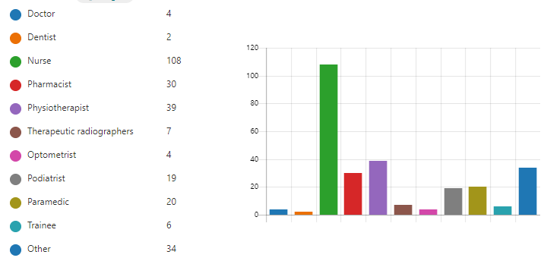
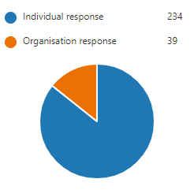
Consultation summary
Consultation ran Friday 26 March - Friday 7 May 2021
273 responses for 25 questions
Notes:
Consultation ran Friday 26 March - Friday 7 May 2021
273 responses for 25 questions
We asked for feedback on whether the sections in the framework were clear, fit for purpose and relevant for all prescribers still. What was missing, needed deleting/changing and what they thought of the new additions.
We asked how people used the framework, the barriers to using it, how it would be promoted, and supporting resources needed in practice.
Feedback was mainly positive and showed the framework is used and needed to support safe prescribing practice

Slide 17
What was updated – key changes

Slide 18
Key changes - framework
Expanded scope
New further information sections added
New key themes added
Now 75 supporting statements (12 new)
1 supporting statement deleted
Professionalism section integrated into framework
For further information on the new additions, changes and supporting tools, please see the RPS website: https://www.rpharms.com/cfap
Notes:
Expanded scope to include setting (requested by task and finish group).
Now 75 supporting statements (12 new) - reflect key themes identified during the review and consultation and literature review
New key themes include: consultation skills, health literacy, documentation, potential vulnerabilities (e.g. mental health or safeguarding issues), social prescribing, eco prescribing and sustainability, equality, inclusivity and developing cultural competence, reducing waste, data protection, managing risk and supporting others (e.g. mentoring, becoming a DPP).
1 supporting statement deleted and merged
New "further information" sections under each competency provide prescribers with information and examples (list not exhaustive or definitive), which provide clarity and meaning to the supporting statements. The recommendation for this competency framework is to use it alongside any relevant further information sections to support implementation into practice. (Requested through the open consultation and review)
Professionalism – no longer a separate section now merged into framework (requested by task and finish group). Includes importance of always applying and demonstrating professionalism to all aspects of practice. Importance of using own professional codes of conduct, standards and guidance alongside the framework. Principles of professionalism are the same across the professions and these are behaviours that healthcare professionals should always be demonstrating, not just for prescribing. More focus on scope of practice - responsible for practising within their own scope of practice and competence, including delegating where appropriate, seeking support when required and using their acquired knowledge, skills and professional judgement.
More focus on scope of practice - responsible for practising within their own scope of practice and competence, including delegating where appropriate, seeking support when required and using their acquired knowledge, skills and professional judgement.
For further information on the new additions, changes and supporting tools, please see the RPS website: https://www.rpharms.com/cfap

Slide 19
What was updated – website

Slide 20
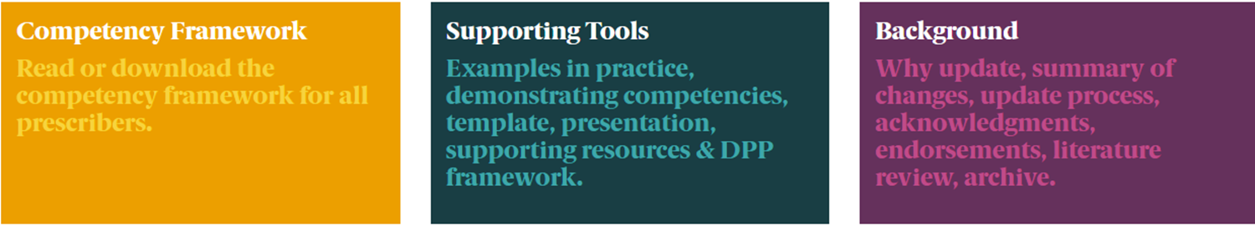
Competency framework homepage
For further information, please see the RPS website: https://www.rpharms.com/cfap
Notes:
New and updated website
Open access
Improved navigation
Main hub page with 3 new sub pages (Requested through the open consultation)
Sub pages include:
Competency framework page
Supporting tools
Background
Further info in next slides

Slide 21
What’s new on the website
Web version
Welsh version
Supporting resources
Ways of evidencing competencies
Examples of use in practice
Summary of changes
For further information, please see the RPS website: https://www.rpharms.com/cfap
Notes:
New web version – interactive links
New Welsh language version (Requested through task and finish group)
New section on what’s been updated (Requested through the open consultation)
New examples of use of framework in practice – call to action to share examples with RPS
New ways of evidencing/demonstrating competencies to support (Requested through open consultation)
New supporting resources section – links to useful sources of information to support competencies (Requested through the open consultation)

Slide 22
Competency framework page

Slide 23


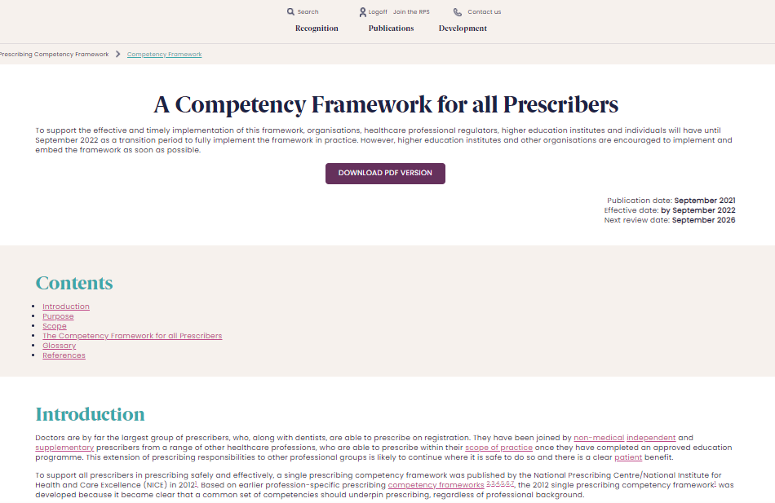
Notes:
Screen shot of cover pages and website
Framework page – here you will find a new interactive web version and new Welsh and English PDF
Design updated

Slide 24
Supporting tools page

Slide 25
Supporting tools content
EXAMPLES OF USES OF THE FRAMEWORK IN PRACTICE
TEMPLATE OF THE FRAMEWORK
POWERPOINT SLIDE SET
SUPPORTING RESOURCES
WAYS OF DEMONSTRATING/EVIDENCING COMPETENCIES
A COMPETENCY FRAMEWORK FOR DESIGNATED PRESCRIBING PRACTITIONERS
For further information on the supporting tools please see the RPS website: https://www.rpharms.com/cfap
Notes:
There are some useful tools on the RPS website to support you with implementing the competency framework for all prescribers. On this page you'll find.
Uses of the framework in practice – Here are some ways prescribers, patients, regulators, professional bodies, education providers and organisation use the framework in their day-to-day practice. Share your examples with support@rpharms.com
Ways of demonstrating/evidencing competencies – suggestions on ways you can demonstrated and evidence competencies list not exhaustive (recommended through group and consultation)
Template of the framework - Here you can download a Word version of the competency framework for all prescribers.
PowerPoint slide set –Here you can find a Powerpoint presentation on the content of the framework and also the updates. It can be used and adapted as required for learning purposes. However, it is not to be used by external users/organisations for commercial gain.
Supporting resources – Here are some useful links and further reading to support you with demonstrating the competencies and supporting statements.
A competency framework for designated prescribing practitioners – RPS worked with multi-disciplinary experts and patients to develop and publish a competency framework for designated prescribing practitioners in all prescribing professions, to help train safe and effective non-medical prescribers (NMPs) during their period of learning in practice (PLP) under the supervision of an experienced designated prescribing practitioner. The practitioner role is central to the PLP, and as such assuring the quality of this role is essential. The competency framework for designated prescribing practitioners will help programme providers, employing organisations, trainees and experienced prescribers to understand the expectations for a DPP through competency descriptors.

Slide 26
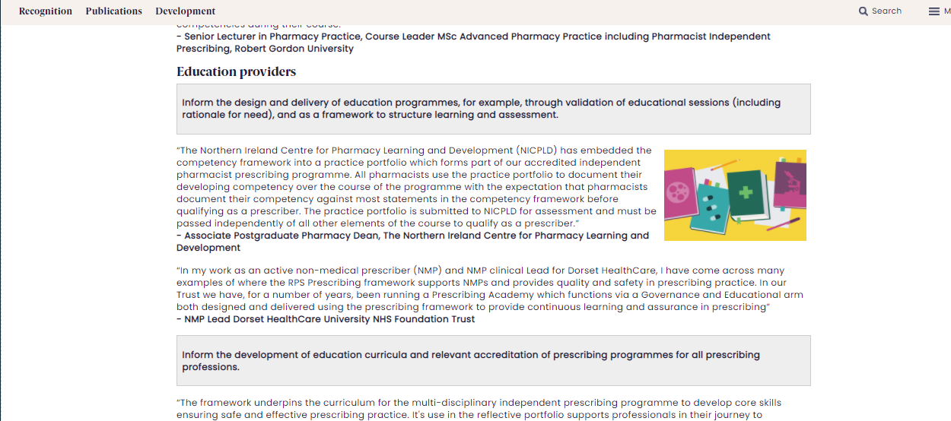
Examples of use in practice
Notes:
Here’s a screen shot of the new ‘examples of use in practice’ section on the website.
Here you will find ways prescribers, patients, regulators, professional bodies, education providers and organisations use the framework in their day to day practice.
We also have a call to action and ask others to share their examples too
For further information on the supporting tools please see the RPS website: https://www.rpharms.com/cfap

Slide 27
Demonstrating/evidencing competencies
REAL LIFE PRACTICE EXAMPLES
SUPERVISION/
OBSERVATIONS
PORTFOLIOS MAPPED TO COMPETENCIES
AUDITS
CASE-BASED DISCUSSIONS
PEER DISCUSSIONS
& FEEDBACK
REFLECTIVE ACCOUNTS
CPD RECORDS
For further examples, please see the RPS website:
https://www.rpharms.com/cfap
Notes:
In this new section on the website you will find suggestions on ways to document evidence
There are various ways in which you may wish to document or evidence your competencies (list not exhaustive or definitive).
However, discuss requirements with your educational supervisors, employer, NMP lead or DPP first.
Real life practice examples
Supervision of your work
Observation of others and your practice and clinical assessment skills
Portfolios mapped to competencies
Audits
Case-based discussions
Peer discussions & feedback
Reflective accounts - identifying gaps
CPD records - Setting SMART objectives

Slide 28
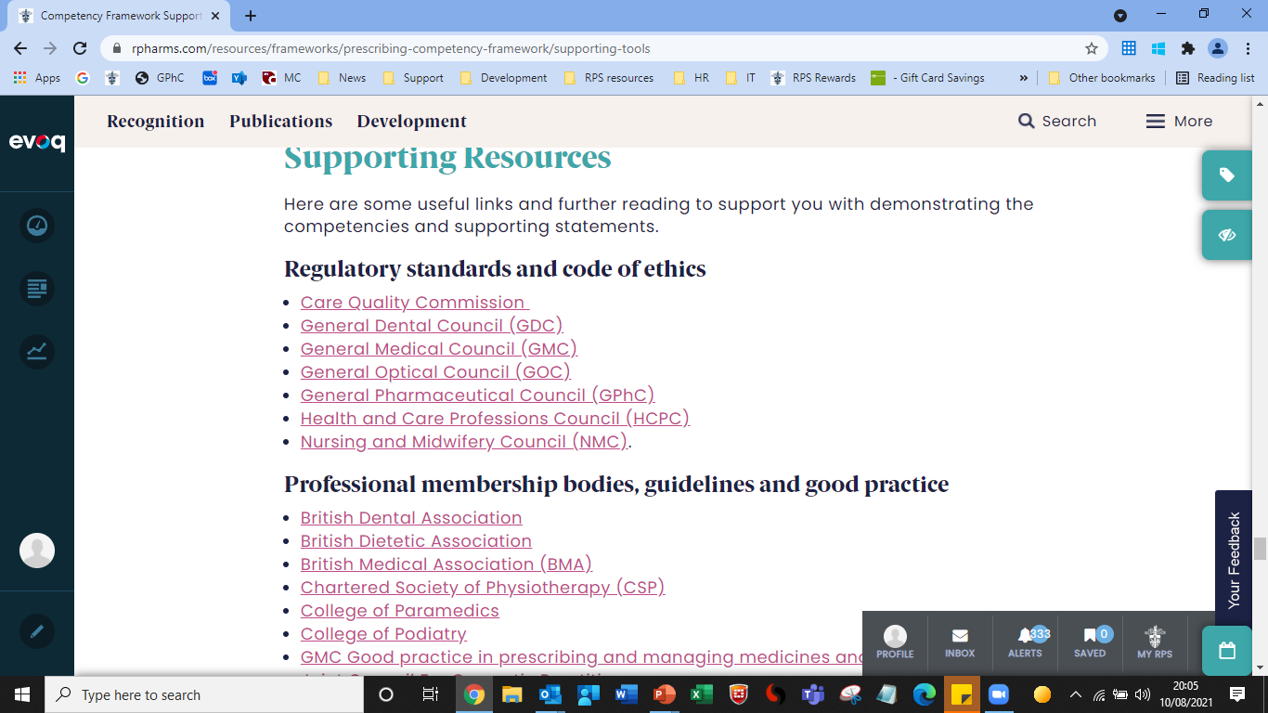
Supporting resources
For further examples, please see the RPS website:
https://www.rpharms.com/cfap
Notes:
Here is a screenshot of the new ‘supporting resources’ section on the website
Here you will find some useful links and further reading to support you with demonstrating the competencies and supporting statements. Topics covered include:
Regulatory standards and code of ethics
Professional membership bodies, guidelines and good practice
Clinical - Prescribers should also refer to local policies, clinical guidelines, as directed by each professional group and specific field of practice.
Medicines and medicines safety
Frameworks and reports
Legislation
Ethical
We ask for people to share examples
We are keen to hear about the resources you use to support the implementation of the competency framework for all prescribers in practice. To support users of the framework, you can share your suggestions that we haven’t mentioned by emailing us at support@rpharms.com.

Slide 29
Background page

Slide 30
Background page content
BACKGROUND AND FAQS
WHY THE FRAMEWORK WAS UPDATED
SUMMARY OF CHANGES MADE
HOW THE FRAMEWORK WAS UPDATED
ACKNOWLEDGMENTS AND ENDORSEMENTS
LITERATURE REVIEW AND ARCHIVE
Notes:
On this page you will find information on the competency framework such as
why the competency framework was updated in 2021,
what was updated,
how it was updated,
who was involved
who endorsed.
You will also find the literature review as well as the archived 2016 version of the competency framework.

Slide 31
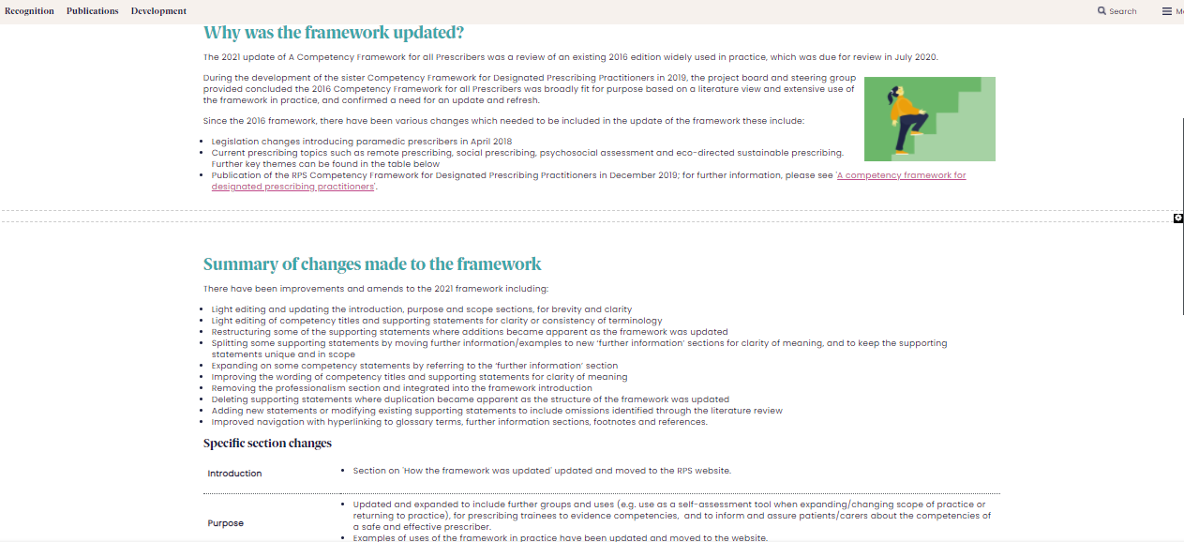
What was updated and why?
Notes:
Here is a screenshot of the background page and the new sections on why the framework was updated and what was updated

Slide 32
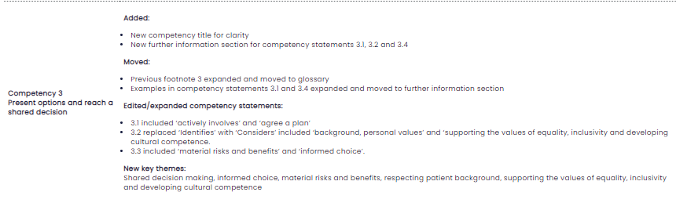
What was updated and why?
Notes:
Here is a screenshot of the background page and the new sections what was updated in further detail

Slide 33
The framework competencies 1-10
Structure and content
3
Notes:
The competencies - Light teal text = new additions.
Use framework alongside the “further information boxes” in framework

Slide 34
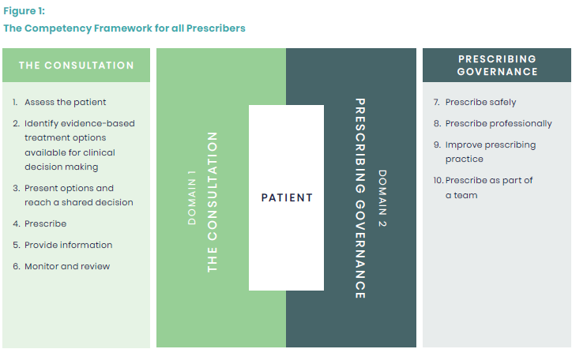
Structure of the framework
TWO DOMAINS
COMPETENCY AND SUPPORTING STATEMENTS
FURTHER INFORMATION
Notes:
Structure of the framework
2 domains
Domain 1 - the consultation: competencies that the prescriber should demonstrate during the consultation
Domain 2 - prescribing governance: competencies that the prescriber should demonstrate with respect to prescribing governance
10 competencies (updated 2 titles for clarity)
Now 75 supporting statements under the competencies - Each of these competencies contains several supporting statements related to the prescriber role which describe the activity or outcome that the prescriber should actively and routinely demonstrate.
Updated diagram design– figure 1 design updated, concept same e.g. patient at centre and domains surround it
Interactive links to glossary and further information sections
New Further information sections - The further information sections under each competency provide prescribers with information and examples (list not exhaustive or definitive), which provide clarity and meaning to the supporting statements. The recommendation for this competency framework is to use it alongside any relevant further information sections to support implementation into practice.
Please note:
The framework competencies and supporting statements are not in any particular order. The numbering is mainly to support mapping purposes and does not reflect the level of importance of the statement. They are not designed to be used as a script or in isolation as they may overlap with others.
Due to the generic nature of the framework, it may be that not every competency or supporting statement is relevant to your practice or setting. However, you should still be able to consider how you could demonstrate the supporting statement.

Slide 35
1. Assess the patient
1.1 Undertakes the consultation in an appropriate setting.
1.2 Considers patient dignity, capacity, consent and confidentiality.
1.3 Introduces self and prescribing role to the patient/carer and confirms patient/carer identity.
1.4 Assesses the communication needs of the patient/carer and adapts consultation appropriately.
1.5 Demonstrates good consultation skills and builds rapport with the patient/carer.
1.6 Takes and documents an appropriate medical, psychosocial and medication history including allergies and intolerances.
1.7 Undertakes and documents an appropriate clinical assessment.
Notes:
Light teal sections = new additions/changes.

Slide 36
1. Assess the patient
1.8 Identifies and addresses potential vulnerabilities that may be causing the patient/carer to seek treatment.
1.9 Accesses and interprets all available and relevant patient records to ensure knowledge of the patient’s management to date.
1.10 Requests and interprets relevant investigations necessary to inform treatment options.
1.11 Makes, confirms or understands, and documents the working or final diagnosis by systematically considering the various possibilities (differential diagnosis).
1.12 Understands the condition(s) being treated, their natural progression, and how to assess their severity, deterioration and anticipated response to treatment.
Notes:
Light teal sections = new additions/changes.

Slide 37
1. Assess the patient
1.13 Reviews adherence (and non-adherence) to, and effectiveness of, current medicines.
1.14 Refers to or seeks guidance from another member of the team, a specialist or appropriate information source when necessary.
Notes:
Light teal sections = new additions/changes.

Slide 38
2. Identify evidence-based treatment options available for clinical decision making
2.1 Considers both non-pharmacological and pharmacological treatment approaches.
2.2 Considers all pharmacological treatment options including optimising doses as well as stopping treatment (appropriate polypharmacy and deprescribing).
2.3 Assesses the risks and benefits to the patient of taking or not taking a medicine or treatment.
2.4 Applies understanding of the pharmacokinetics and pharmacodynamics of medicines, and how these may be altered by individual patient factors.
2.5 Assesses how co-morbidities, existing medicines, allergies, intolerances, contraindications and quality of life impact on management options.
Notes:
Light teal sections = new additions/changes.

Slide 39
2. Identify evidence-based treatment options available for clinical decision making
2.6 Considers any relevant patient factors and their potential impact on the choice and formulation of medicines, and the route of administration.
2.7 Accesses, critically evaluates, and uses reliable and validated sources of information.
2.8 Stays up to date in own area of practice and applies the principles of evidence-based practice.
2.9 Considers the wider perspective including the public health issues related to medicines and their use, and promoting health.
2.10 Understands antimicrobial resistance and the roles of infection prevention, control and antimicrobial stewardship measures.
Notes:
Light teal sections = new additions/changes.

Slide 40
3. Present options and reach a shared decision
3.1 Actively involves and works with the patient/carer to make informed choices and agree a plan that respects the patient’s/carer’s preferences.
3.2 Considers and respects patient diversity, background, personal values and beliefs about their health, treatment and medicines, supporting the values of equality and inclusivity, and developing cultural competence.
3.3 Explains the material risks and benefits, and rationale behind management options in a way the patient/carer understands, so that they can make an informed choice.
Notes:
Light teal sections = new additions/changes.

Slide 41
3. Present options and reach a shared decision
3.4 Assesses adherence in a non-judgemental way; understands the reasons for non-adherence and how best to support the patient/carer.
3.5 Builds a relationship which encourages appropriate prescribing and not the expectation that a prescription will be supplied.
3.6 Explores the patient’s/carer’s understanding of a consultation and aims for a satisfactory outcome for the patient/carer and prescriber.
Notes:
Light teal sections = new additions/changes.

Slide 42
4. Prescribe
4.1 Prescribes a medicine or device with up-to-date awareness of its actions, indications, dose, contraindications, interactions, cautions and adverse effects.
4.2 Understands the potential for adverse effects and takes steps to recognise, and manage them, whilst minimising risk.
4.3 Understands and uses relevant national, regional and local frameworks for the use of medicines.
4.4 Prescribes generic medicines where practical and safe for the patient, and knows when medicines should be prescribed by branded product.
4.5 Accurately completes and routinely checks calculations relevant to prescribing and practical dosing.
4.6 Prescribes appropriate quantities and at appropriate intervals necessary to reduce the risk of unnecessary waste.
Notes:
Light teal sections = new additions/changes.

Slide 43
4. Prescribe
4.7 Recognises potential misuse of medicines; minimises risk and manages using appropriate processes.
4.8 Uses up-to-date information about the availability, pack sizes, storage conditions, excipients and costs of prescribed medicines.
4.9 Electronically generates and/or writes legible, unambiguous and complete prescriptions which meet legal requirements.
4.10 Effectively uses the systems necessary to prescribe medicines.
4.11 Prescribes unlicensed and off-label medicines where legally permitted, and unlicensed medicines only if satisfied that an alternative licensed medicine would not meet the patient's clinical needs.
4.12 Follows appropriate safeguards if prescribing medicines that are unlicensed, off-label, or outside standard practice.
Notes:
Light teal sections = new additions/changes.

Slide 44
4. Prescribe
4.13 Documents accurate, legible and contemporaneous clinical records.
4.14 Effectively and securely communicates information to other healthcare professionals involved in the patient’s care, when sharing or transferring care and prescribing responsibilities, within and across all care settings.
Notes:
Light teal sections = new additions/changes.

Slide 45
5. Provide information
5.1 Assesses health literacy of the patient/carer and adapts appropriately to provide clear, understandable and accessible information.
5.2 Checks the patient’s/carer’s understanding of the discussions had, actions needed and their commitment to the management plan.
5.3 Guides the patient/carer on how to identify reliable sources of information about their condition, medicines and treatment.
5.4 Ensures the patient/carer knows what to do if there are any concerns about the management of their condition, if the condition deteriorates or if there is no improvement in a specific timeframe.
5.5 Encourages and supports the patient/carer to take responsibility for their medicines and self-manage their condition.
Notes:
Light teal sections = new additions/changes.

Slide 46
6. Monitor and review
6.1 Establishes and maintains a plan for reviewing the patient’s treatment.
6.2 Establishes and maintains a plan to monitor the effectiveness of treatment and potential unwanted effects.
6.3 Adapts the management plan in response to on-going monitoring and review of the patient’s condition and preferences.
6.4 Recognises and reports suspected adverse events to medicines and medical devices using appropriate reporting systems.
Notes:
Light teal sections = new additions/changes.

Slide 47
7. Prescribe safely
7.1 Prescribes within own scope of practice, and recognises the limits of own knowledge and skill.
7.2 Knows about common types and causes of medication and prescribing errors, and knows how to minimise their risk.
7.3 Identifies and minimises potential risks associated with prescribing via remote methods.
7.4 Recognises when safe prescribing processes are not in place and acts to minimise risks.
7.5 Keeps up to date with emerging safety concerns related to prescribing.
7.6 Reports near misses and critical incidents, as well as medication and prescribing errors using appropriate reporting systems, whilst regularly reviewing practice to prevent recurrence.
Notes:
Light teal sections = new additions/changes.

Slide 48
8. Prescribe professionally
8.1 Ensures confidence and competence to prescribe are maintained.
8.2 Accepts personal responsibility and accountability for prescribing and clinical decisions, and understands the legal and ethical implications.
8.3 Knows and works within legal and regulatory frameworks affecting prescribing practice.
8.4 Makes prescribing decisions based on the needs of patients and not the prescriber’s personal views.
8.5 Recognises and responds to factors that might influence prescribing.
8.6 Works within the NHS, organisational, regulatory and other codes of conduct when interacting with the pharmaceutical industry.
Notes:
Light teal sections = new additions/changes.

Slide 49
9. Improve prescribing practice
9.1 Improves by reflecting on own and others’ prescribing practice, and by acting upon feedback and discussion.
9.2 Acts upon inappropriate or unsafe prescribing practice using appropriate processes.
9.3 Understands and uses available tools to improve prescribing practice.
9.4 Takes responsibility for own learning and continuing professional development relevant to the prescribing role.
9.5 Makes use of networks for support and learning.
9.6 Encourages and supports others with their prescribing practice and continuing professional development.
9.7 Considers the impact of prescribing on sustainability, as well as methods of reducing the carbon footprint and environmental impact of any medicine.
Notes:
Light teal sections = new additions/changes.

Slide 50
10. Prescribe as part of a team
10.1 Works collaboratively as part of a multidisciplinary team to ensure that the transfer and continuity of care (within and across all care settings) is developed and not compromised.
10.2 Establishes relationships with other professionals based on understanding, trust and respect for each other’s roles in relation to the patient’s care.
10.3 Agrees the appropriate level of support and supervision for their role as a prescriber.
10.4 Provides support and advice to other prescribers or those involved in administration of medicines where appropriate.
Notes:
Light teal sections = new additions/changes.

Slide 51
For further details on the framework including the further information sections and glossary terms, please see RPS website: https://www.rpharms.com/cfap

Slide 52
Thank you

